Slide 1
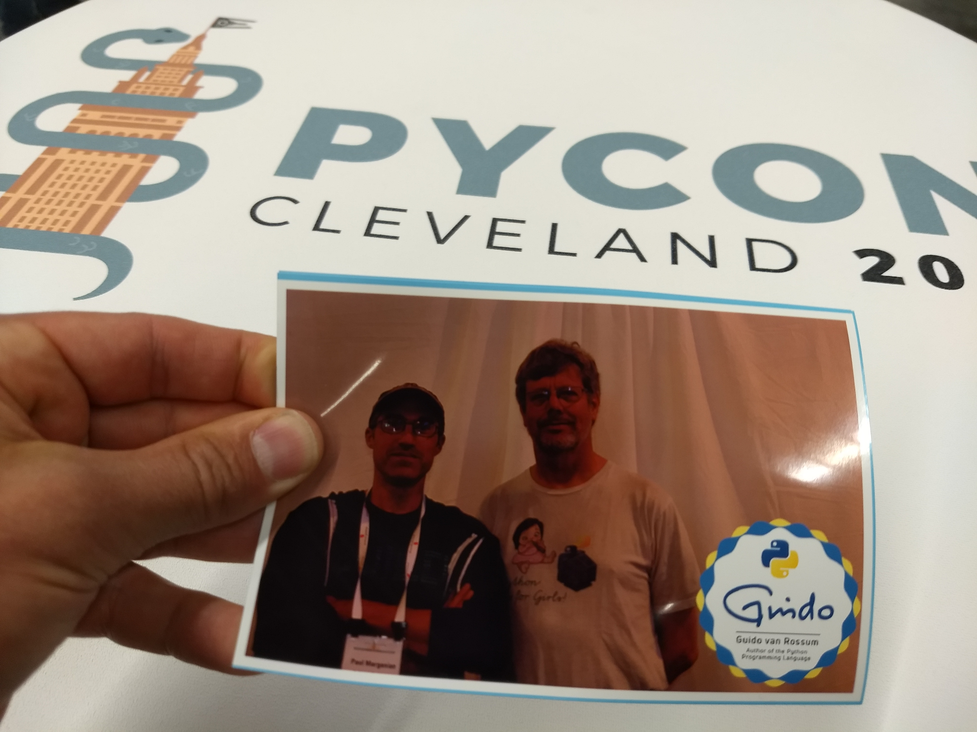
Paul’s PYCON 2018 TALK
What I thought was cool besides all that Data stuff

Slide 2
Talks
WHAT IS THIS MESS? Writing tests for pre-existing code bases: Code https://www.youtube.com/watch?v=LDdUuoI_lIg A good fun review of stuff we already do. Stuff to check out: pytest pytest-django pytest-socket pytest-cov. Also the mock decorator.
Python 3: 10 years later: https://www.youtube.com/watch?v=Aj3KMefwOqI A good historical overview on the move to python 3, and a good motivation for why we should get out of the stone age.
Easy 2D game creation in python w/ Arcade: https://www.youtube.com/watch?v=DAWHMHMPVHU Possibly a great tool for teaching python through making games. Of interest to me.

Slide 3
TALKS (not relevant to GBO)
The Great Failure of 1858: https://www.youtube.com/watch?v=GuNoaAFnTPg Just a fun talk about laying the first transatlantic telegraph cable. Nothing applicable to GBO.
Birding with Python and Machine Learning : https://www.youtube.com/watch?v=938yg4udxSc More cool stuff to do with your RaspberryPi! Again, nothing to apply at GBO. But look how ML is becoming DIY ...
Taking an Average: https://www.youtube.com/watch?v=DlgG0QdrqAU I was amazed that this talk covered what could have been covered in a statistics textbook from 100 years ago. How to take an average over 2 and 3 dimensions. Really? Perhaps this is a reflection on Pcyon attendeess ..

Slide 4
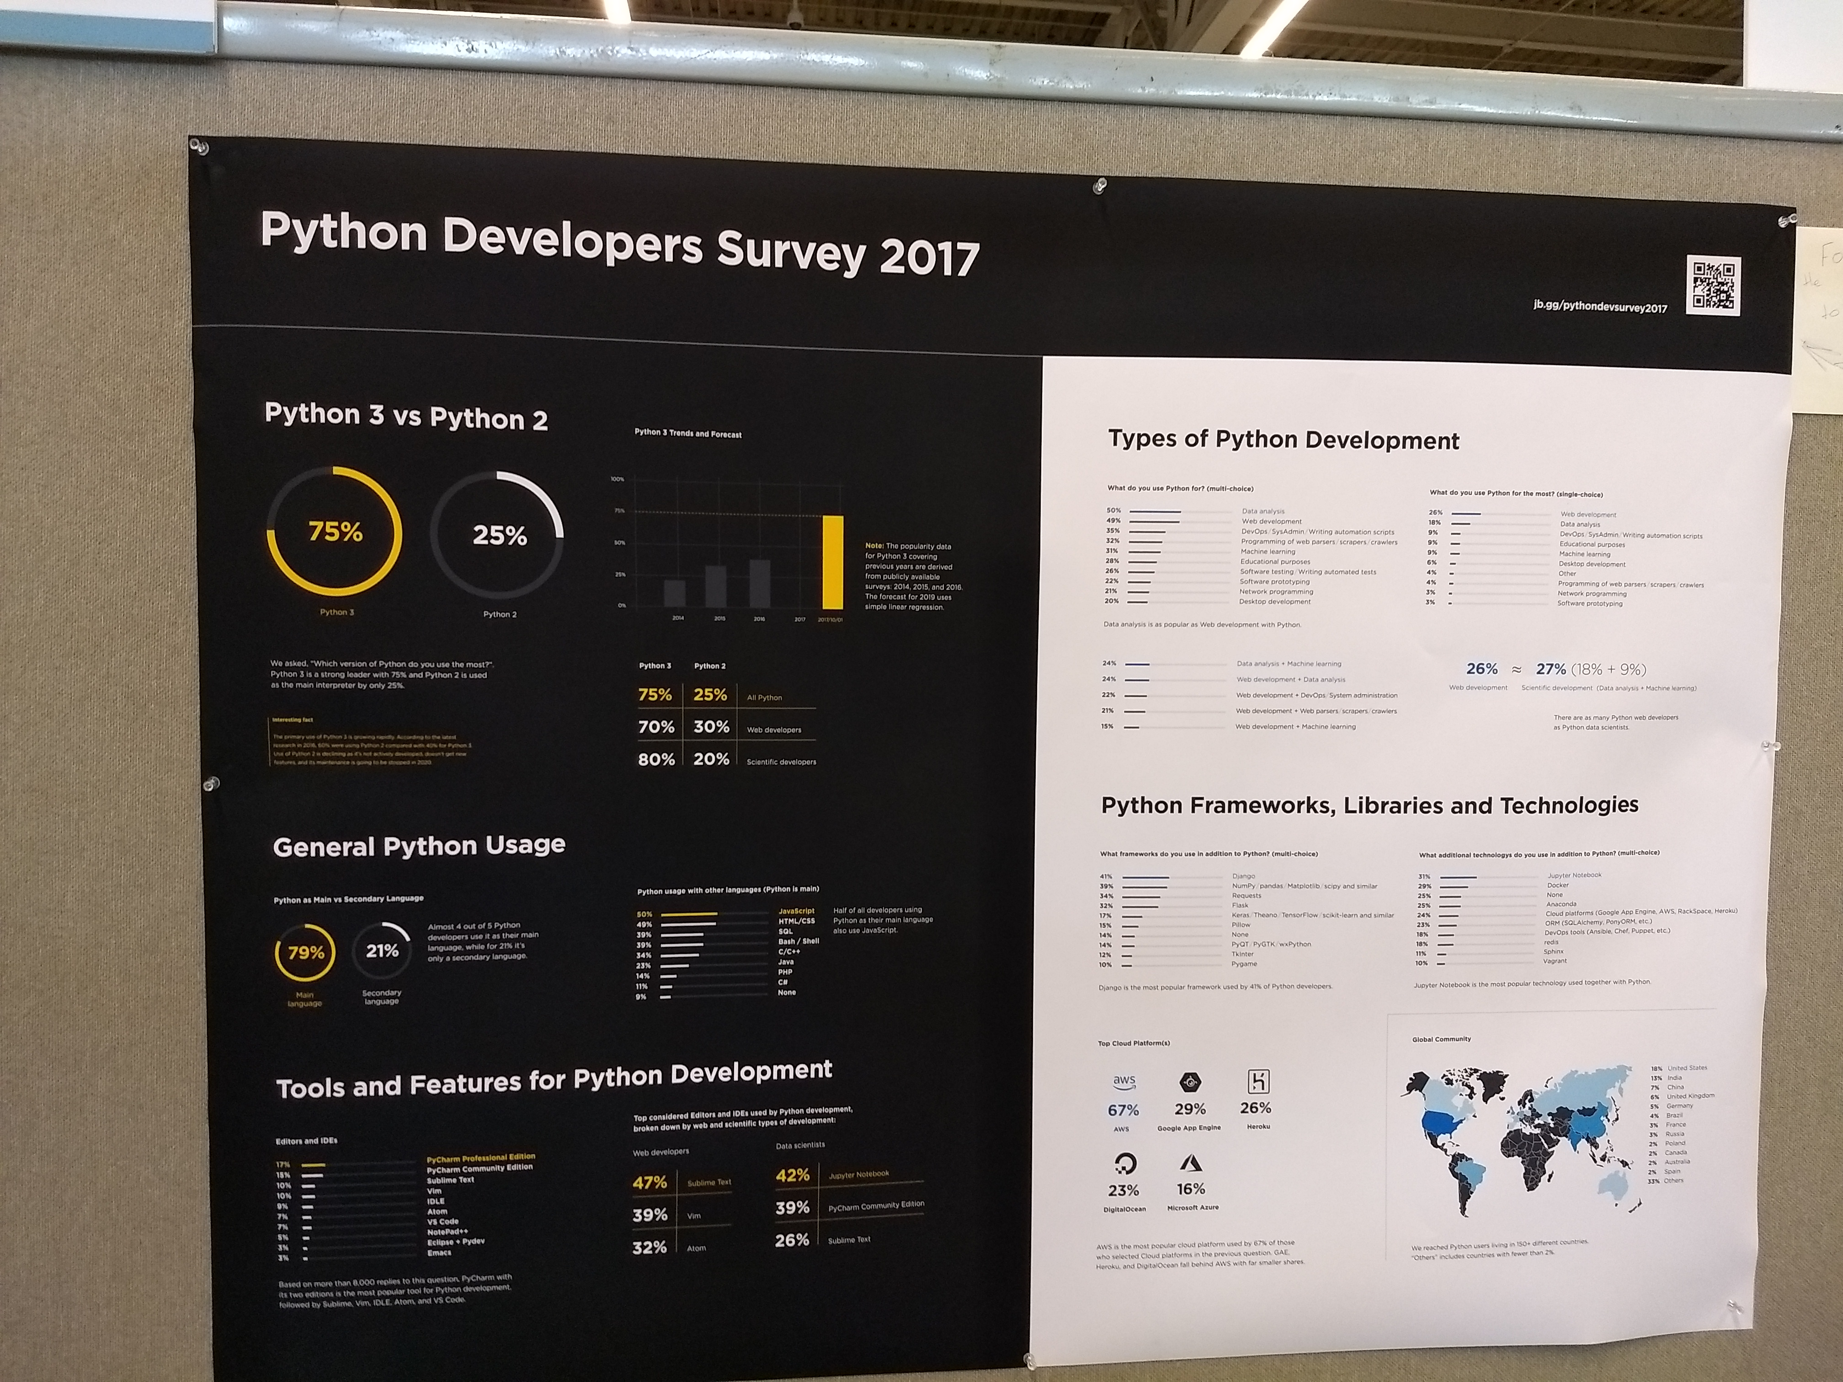
Posters
* mssql-cli: a terminal client for MySQL w/ auto completion and syntax highlighting.
* https://www.jetbrains.com/research/python-developers-survey-2017/. Avery interesting survey! Don in R, btw :)

Slide 5
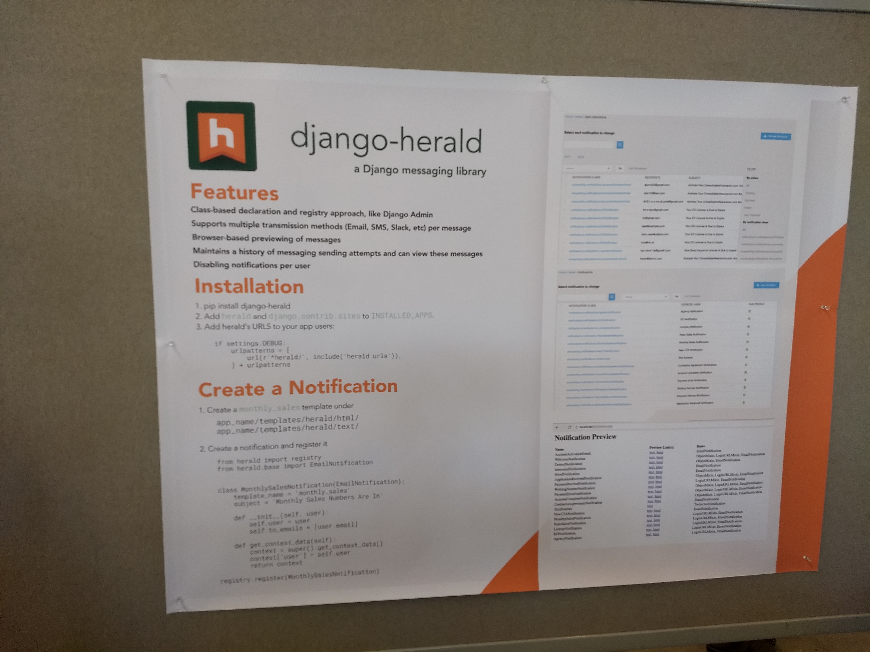
Posters
django-herald: a Django messaging library. messaging via email, SMS, Slack, etc. We asked them about our GBORS email feature, and they knew of no 3rd party package either. They recently rolled their own.

Slide 6
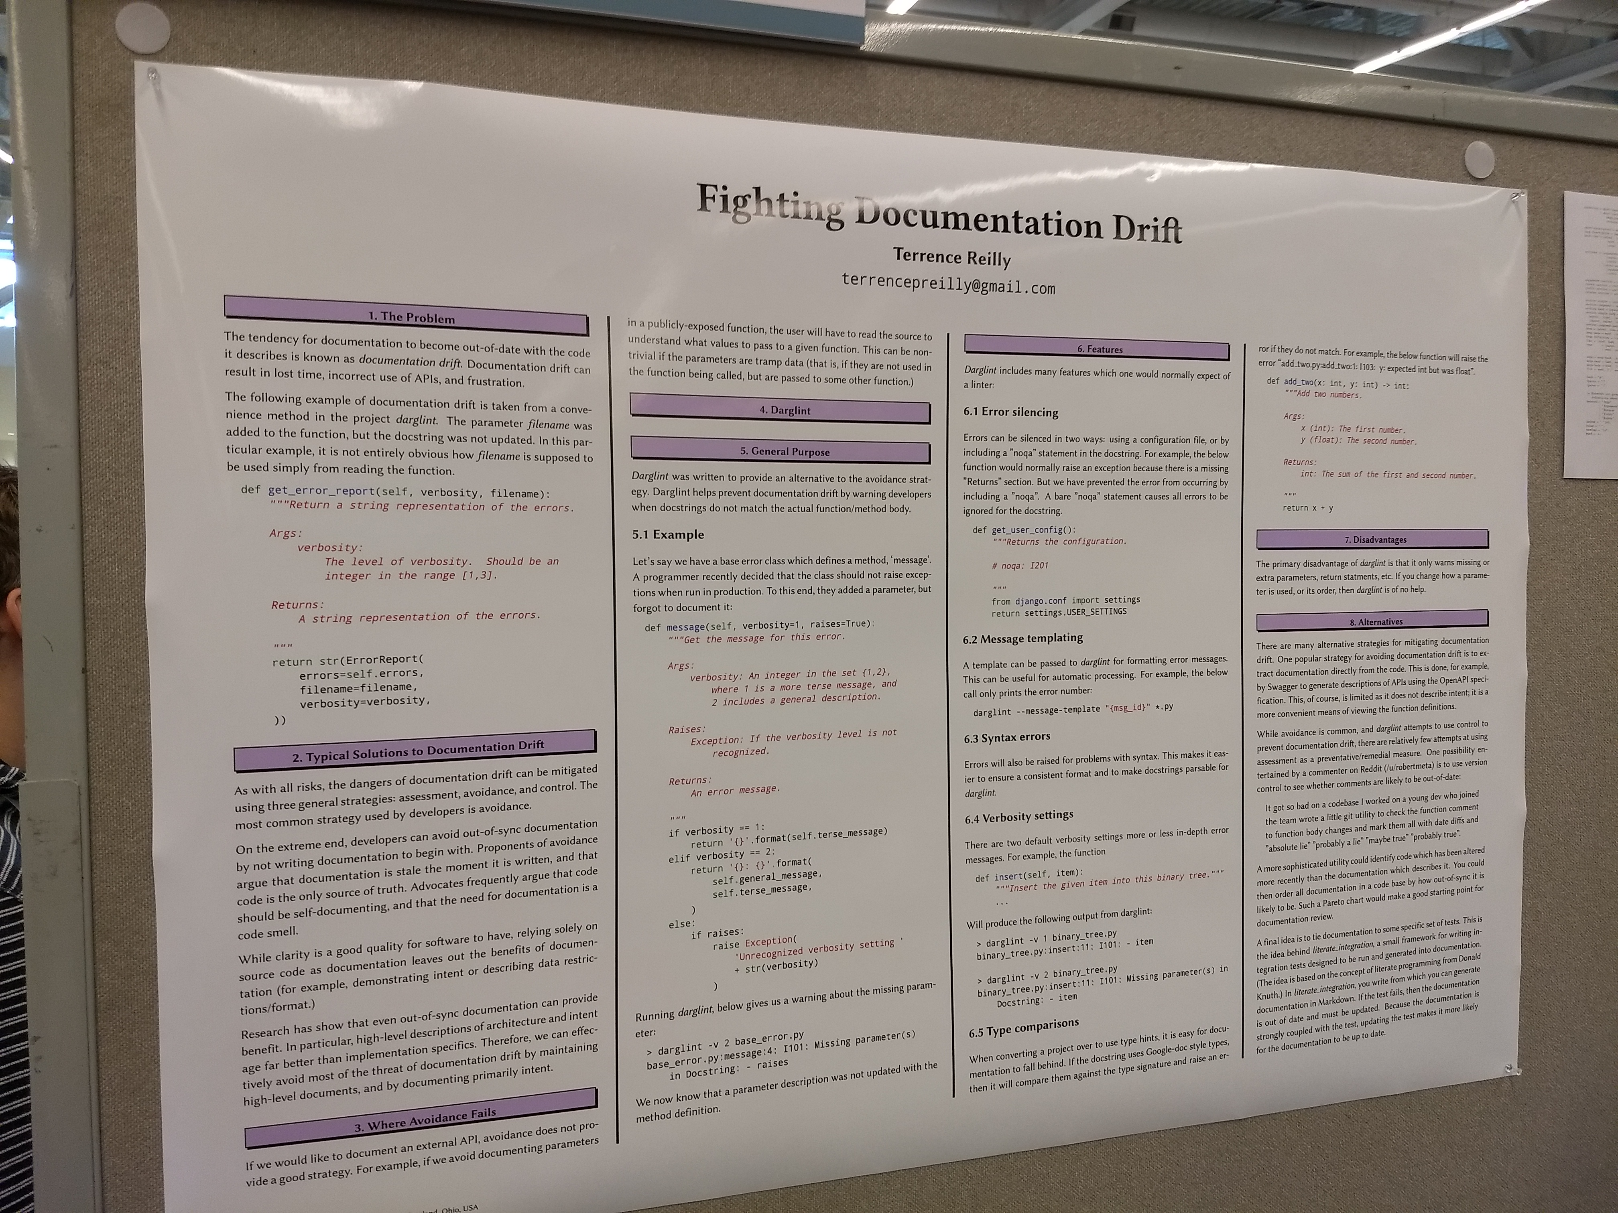
POSTERS
Fighting Documentation Drift (terrencpreilly@gmail.com). Just like it sounds. Could help us?

Slide 7
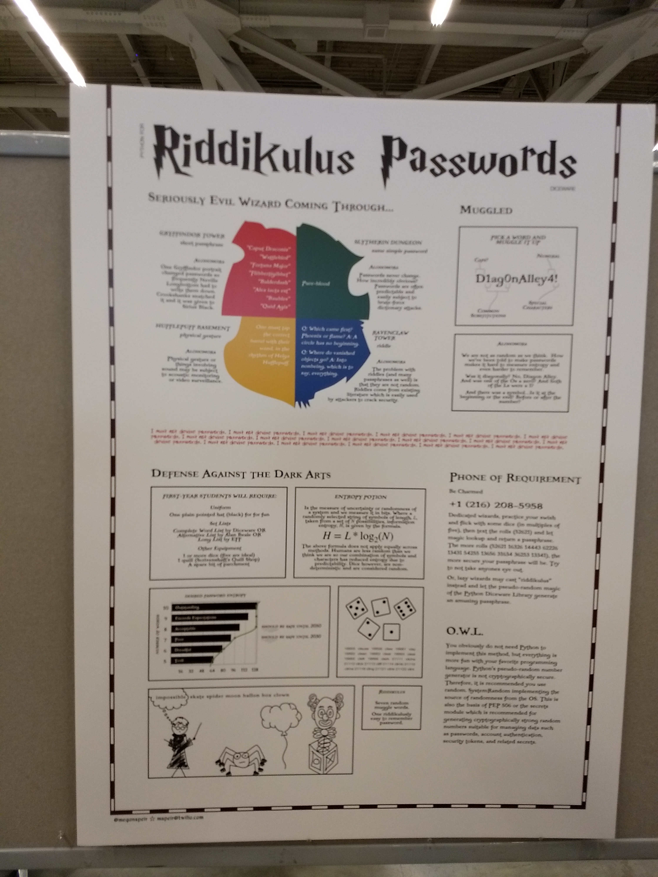
World’s greatest poster

Slide 8
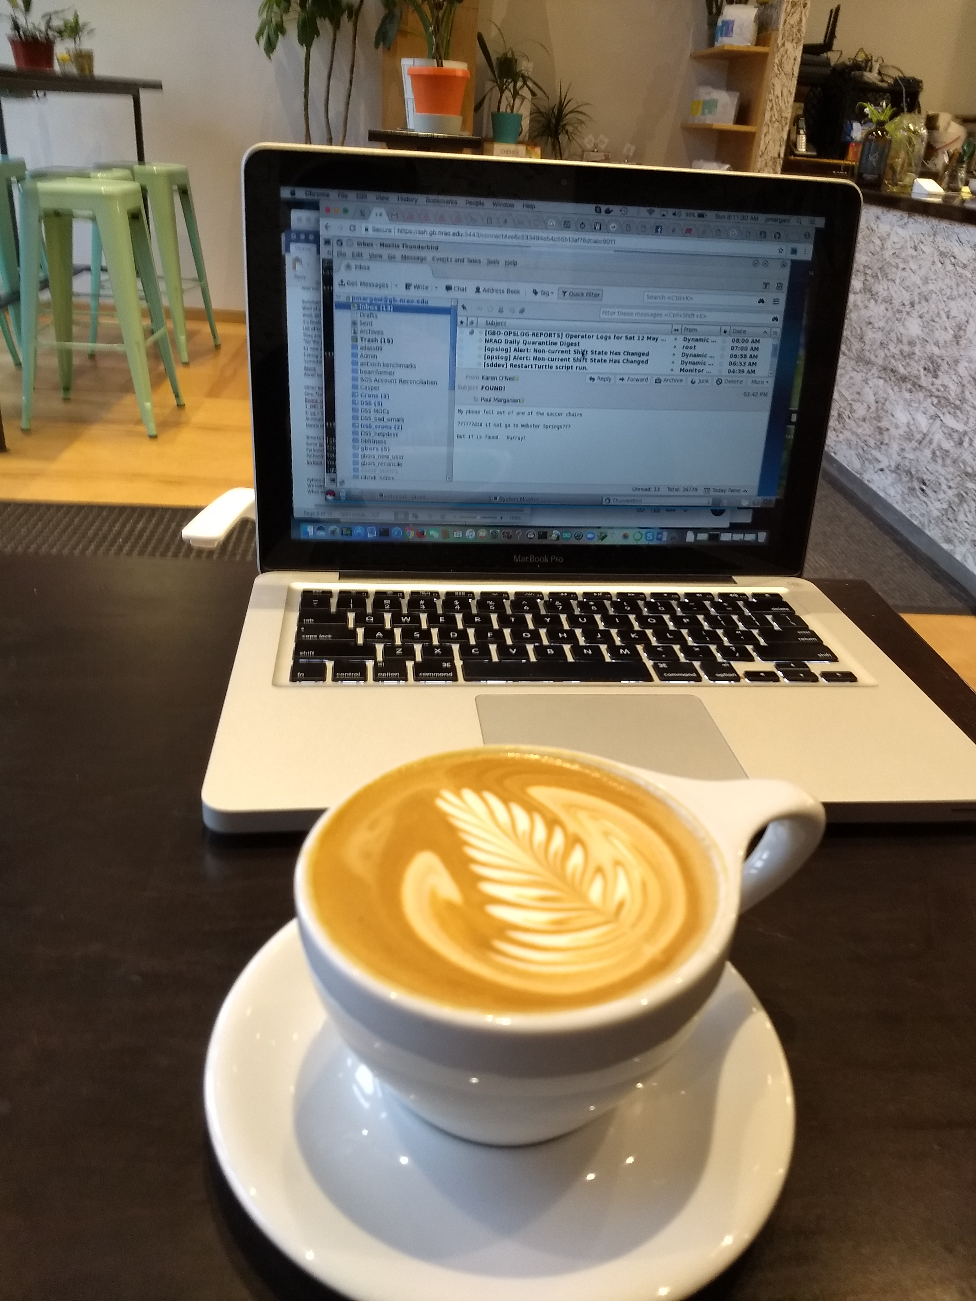
INTERESTING FACTS
Astronomy Open Session was well attended. About 30 people, but few Astronomers. Got dinner w/ folks from Gulf Stream Aerospace - they had similar war stories.
Software Engineers were perhaps a small minority
Downtown Cleveland has at least one awesome coffee shop.

Slide 9
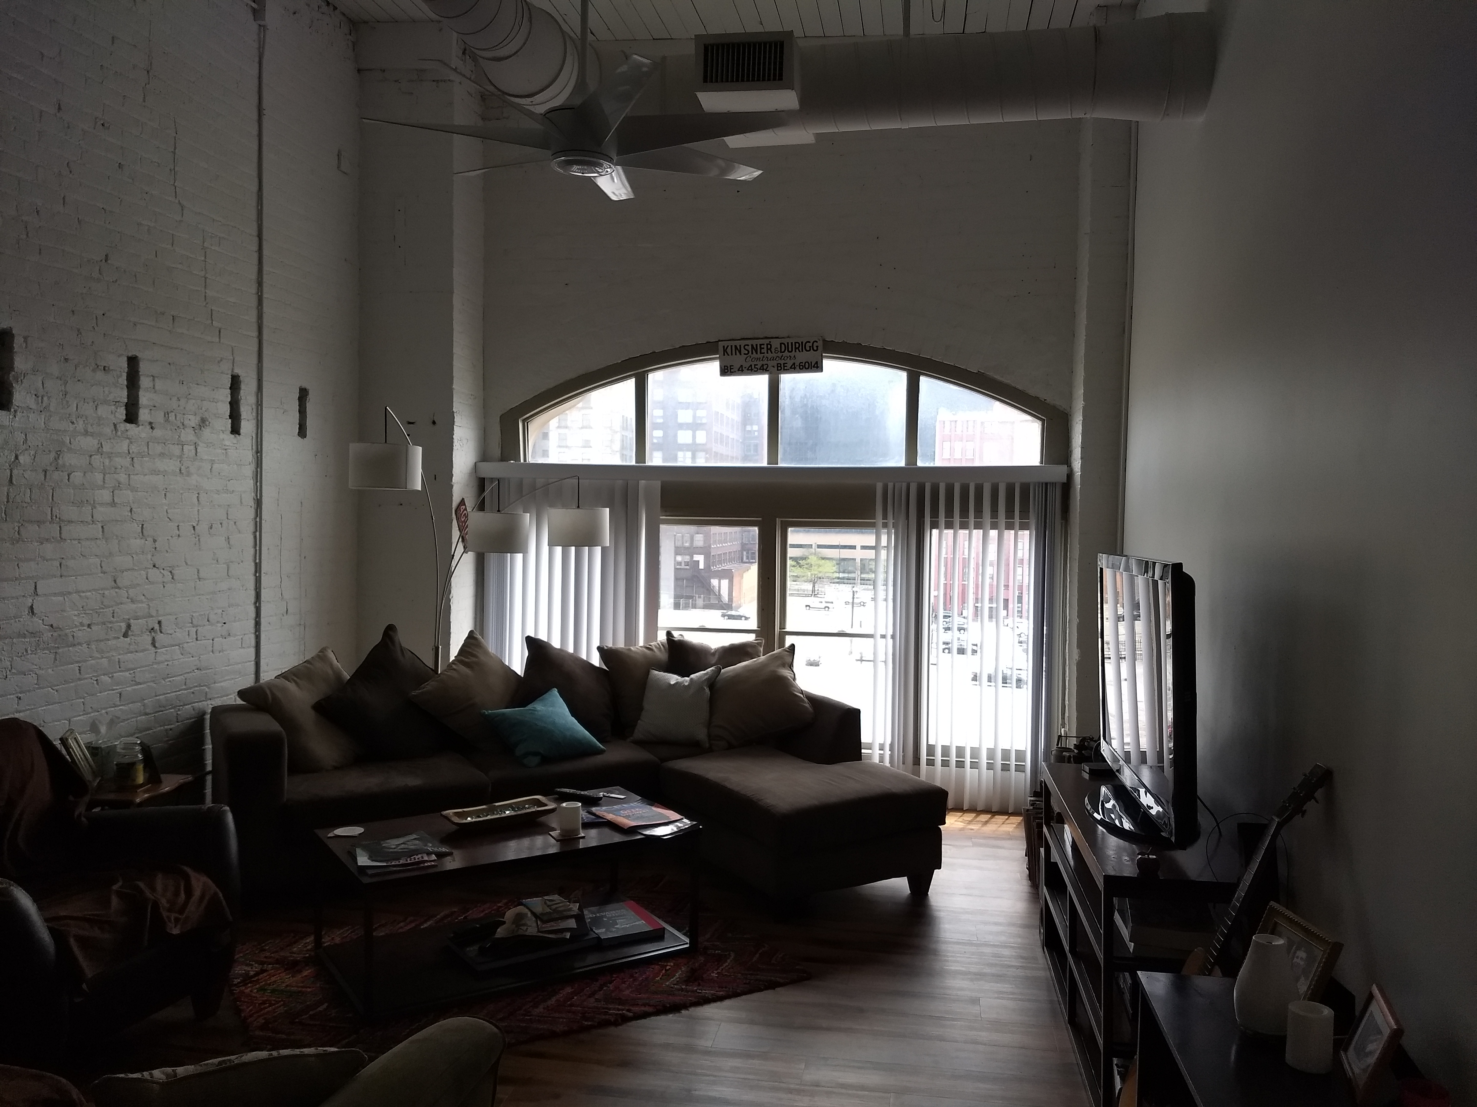
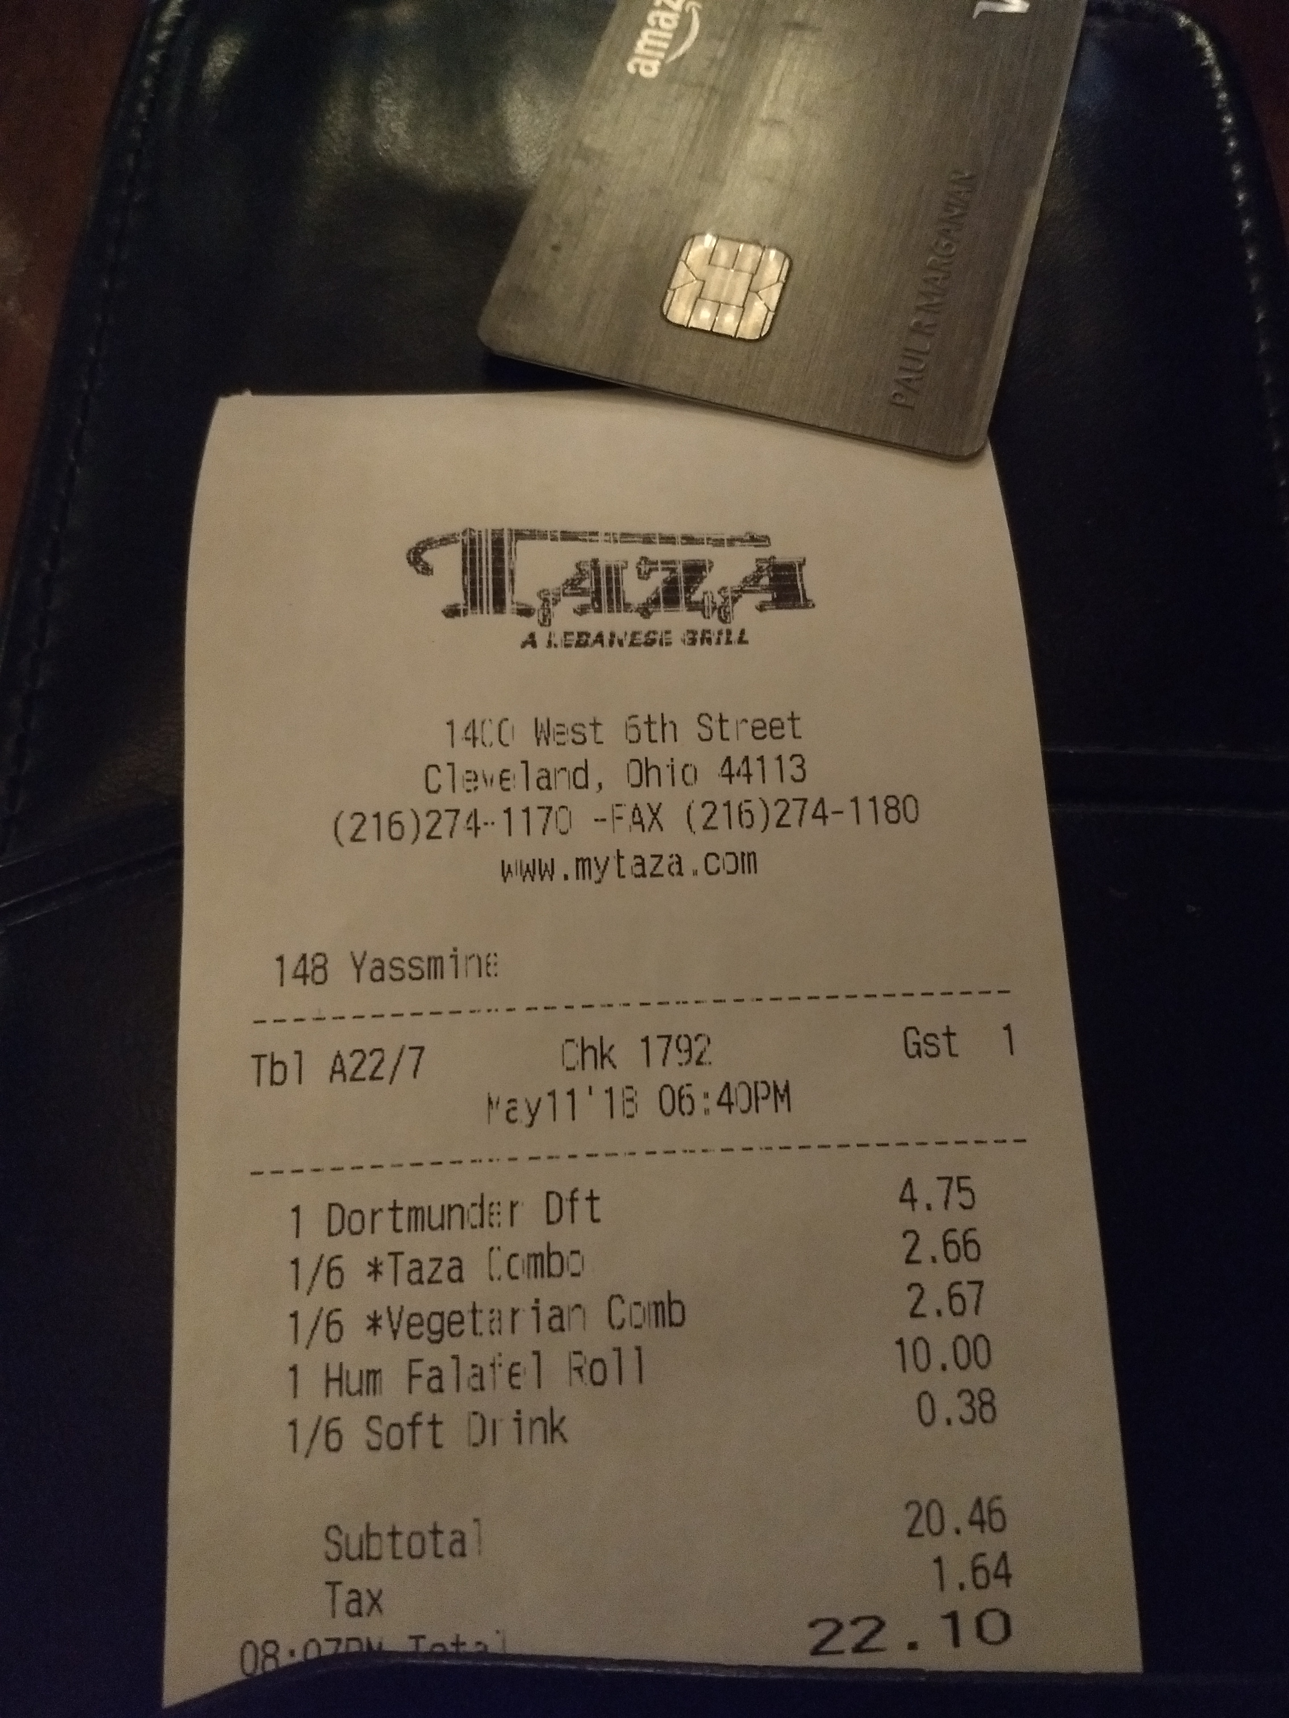
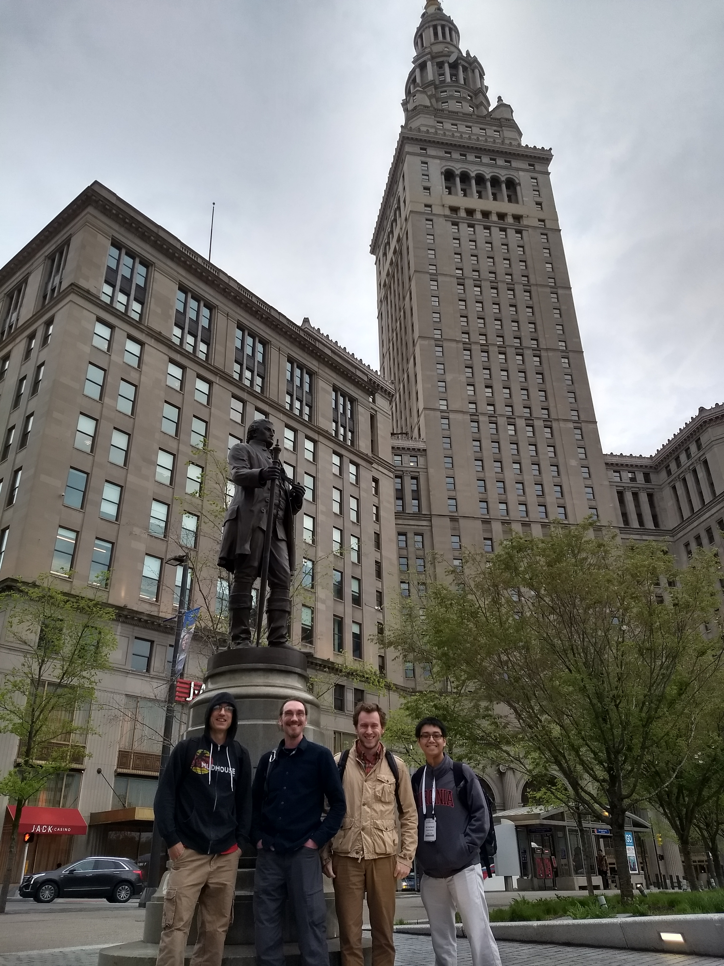
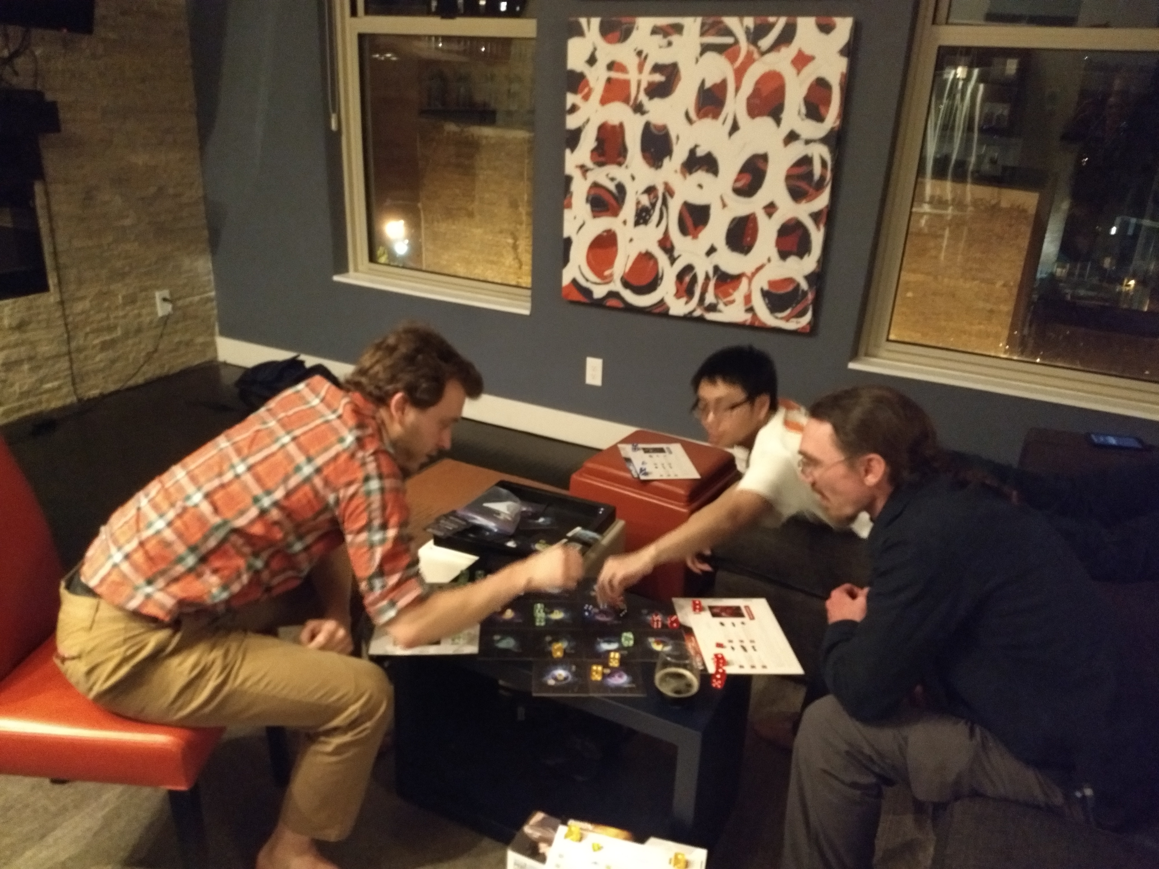
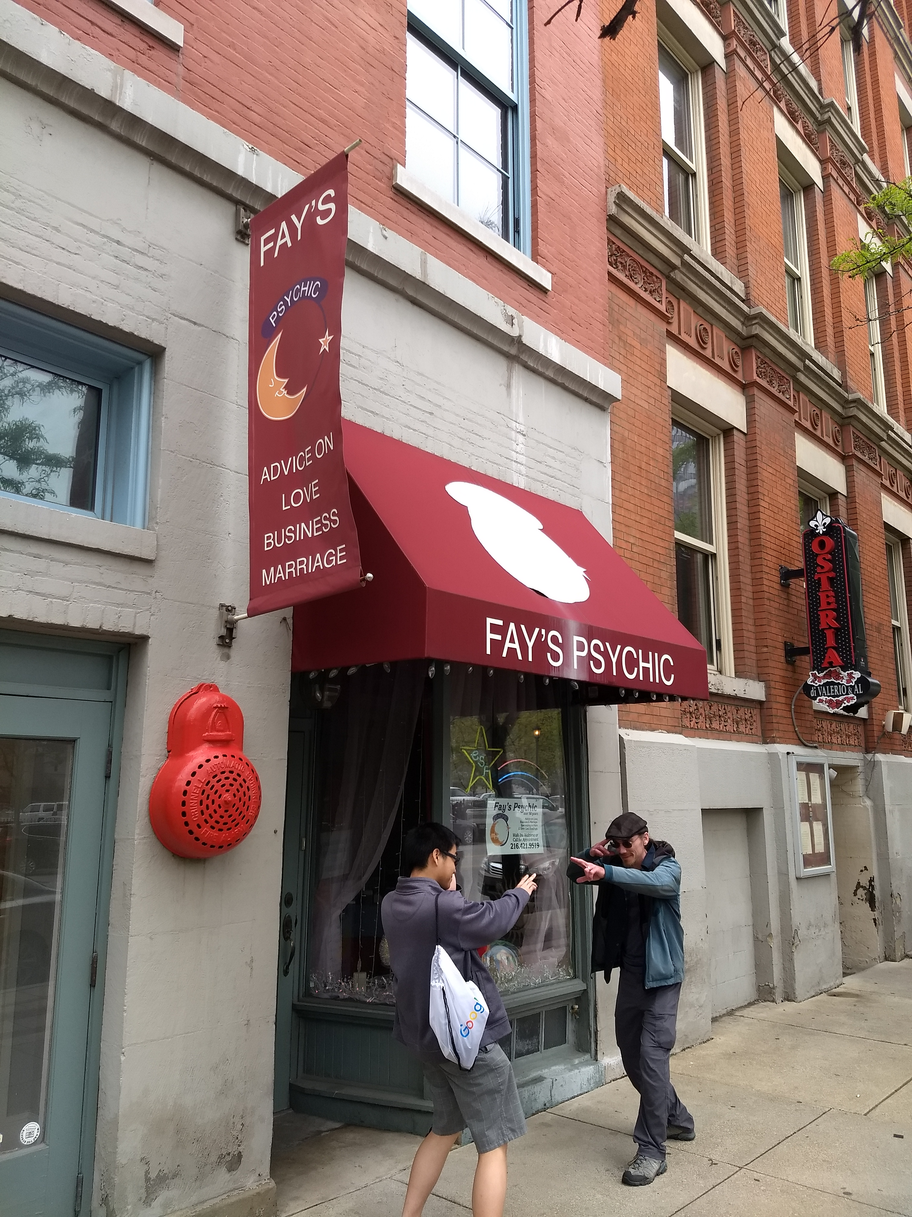

Slide 10
